Slide 1


Prediction of
Coronary Heart Disease
in the next ten years
Muthukumar Kadhirvel​​

Slide 2
Problem statement
DEFINITION
AFFECTED
SYMPTOMS
Coronary heart disease (CHD)
Specific type of heart disease
Heart’s arteries cannot pump enough blood to the heart
18.2 million people in USA
One of the deadliest heart diseases according to CDC
Can vary by person
Chest pain or heart attack
Cardiac arrest
PREDICTION
DATA MODEL
If we can predict CHD early
Stop from a sudden death
Change their lifestyle, medicine, surgery
If we identify the prospective patients
Hospitals/Clinics identify undiagnosed patients who are at risk for the disease
Improves quality of life for patient

Slide 3
Data Processing - EDA
Dataset
Patients' information dataset from Kaggle ​
https://www.kaggle.com/datasets/jiantay33/coronary-prediction
Has 4238 rows and 16 columns
Data Preparation
Handle Missing values based on variable type
No dummy variables needed
Visualization
Histograms – Feature variables with the two levels of the target variable to see if any changes to distribution
Scatter Plots – Check if any correlation between feature variables​

Slide 4
Dataset
Continuous variables – Age/Number of cigarettes smoked in a day/Cholesterol Level/sysBP (Systolic Blood Pressure)/diaBP (Diastolic Blood Pressure)/BMI (Body Mass Index)/Heart Rate Reading/Glucose Level
Ordinal Variables – Highest education received
Binary Variables – Male or Female/If a person smokes or not/Patient on Blood Pressure Medication or not/Patient had stroke already or not/Patient had hypertension already or not/Patient had diabetes already or not
Target variable – Whether the patient got diagnosed with CHD in the next 10 years in binary format

Slide 5
Data Preparation
No Dummy variables needed as categorical variables are binary/ordinal and continuous variables are numeric
Missing values in seven variables:
Education – Replaced with mode as it is an ordinal variable
cigsPerDay – currentSmoker identifies if the patient is a smoker or not. So, we made use of that to identify only smokers and replaced missing values for them with their mean
BPMeds – Good correlation with prevalentHyp field and any time when BPMeds had a value of 1, prevalentHyp also had a value of 1. So replaced missing values with the corresponding value of prevalentHyp
totChol/BMI/heartrate/glucose – Replaced missing values with mean as these are continuous variables

Slide 6
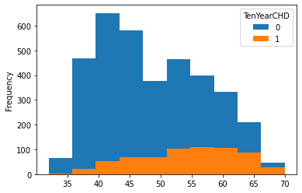
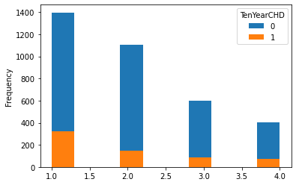
Visualization
Histograms of Age & Education
Age – For persons less than 35 - Very little risk of CHD
Education - Most patients have education level of 1 but the percentage of people having CHD does not seem to depend on education
6

Slide 7
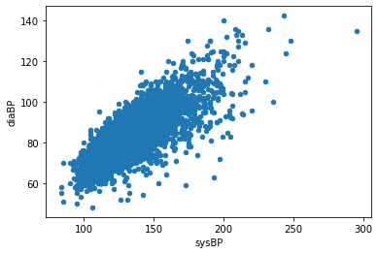
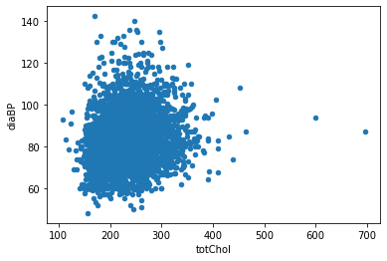
Visualization (Cont.)
Scatter plots of sysBP/diaBP and totChol/diaBP - Typically tied together in medical analysis
High positive correlation between sysBP and diaBP features
No correlation between totChol and diaBP features
7

Slide 8
Models and Metrics
Binary classification problem
Models Used - ​Logistic Regression / Random Forest Classifier / Decision Tree Classifier.
Split into training dataset and test dataset in the ratio of 80% to 20%
Target is the Ten-Year CHD
Features series has the rest of the columns.
Accuracy is used as the evaluation metric and Industry standard is around 70% to 90%
Confusion matrix ensures the number of false positive and false negatives are less

Slide 9
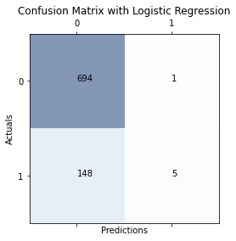
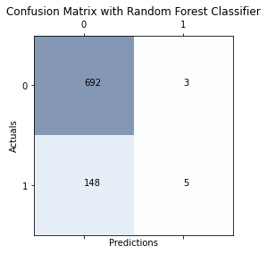
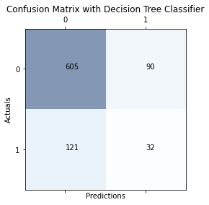
Model Evaluation
Logistic Regression and Random Forest Classifier - Good accuracy but bad at predicting TenYearCHD value of 1
Decision Tree Classifier was far better than the above two models in terms of predicting TenYearCHD value of 1

Slide 10
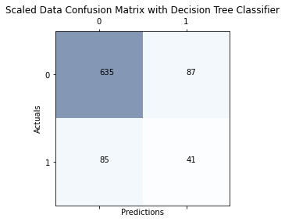
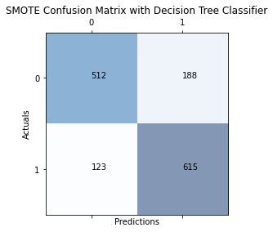
Model Evaluation (Cont.)
MinMaxScaler was performed on the dataset and accuracy and Confusion Matrix yielded better results
Since we are predicting minority class used SMOTE – Synthetic Minority Oversampling Technique
SMOTE created a larger dataset of 7188 rows with equal TenYearCHD value of 0 and 1 compared to 4238 rows
Applying Decision Tree Classifier on the resample dataset yielded better results

Slide 11
CONCLUSION
Decision Tree Classifier model with resample dataset on the scaled data of the original dataset yielded the best results and will be used to go ahead with implementation
Continue to input more sample data that becomes available to retrain our model
Recurring mechanism to keep the model in line with the current data
Challenges - Dataset has limited number of factors
Factors like Race/ Ethnicity/ Income/ Region etc. could also be crucial factors

Slide 12
References
NHLBI (2022). U.S. Department of Health and Human Services. (n.d.). What is coronary heart disease? National Heart Lung and Blood Institute. Retrieved September 11, 2022, from https://www.nhlbi.nih.gov/health/coronary-heart-disease

Slide 13

Thank you
Muthukumar Kadhirvel​​
402-301-2069
mkadhirvel@my365.bellevue.edu

